Slide 1
Economic &
Credit Union
Update
If you have any questions or comments, please contact:
Steven Rick, Chief Economist
Trustage - Economics
800.356.2644, Ext. 665.5454
Steve.rick@TruStage.com
June 2026

Slide 2
3.0% Neutral Interest Rate
2% Inflation
1% Real Equilibrium
3.6%
Source: Federal Reserve

Slide 3
3.0% Neutral Interest Rate
2% Inflation
1% Real Equilibrium
3.6%
Accelerating the
Economy
Source: Federal Reserve

Slide 4
Fastest increase in
interest rates
in 40 years
(5.25)
3.0% Neutral Interest Rate
2% Inflation
1% Real Equilibrium
3.6%
Accelerating the
Economy
Source: Federal Reserve

Slide 5
July 2023
5.35%
Fastest increase in
interest rates
in 40 years
(5.25)
3.0% Neutral Interest Rate
2% Inflation
1% Real Equilibrium
3.6%
Accelerating the
Economy
Source: Federal Reserve

Slide 6
July 2023
5.35%
Fastest increase in
interest rates
in 40 years
(5.25)
3.0% Neutral Interest Rate
2% Inflation
1% Real Equilibrium
Braking the Economy
3.6%
Accelerating the
Economy
Source: Federal Reserve

Slide 7
July 2023
5.35%
Fastest increase in
interest rates
in 40 years
(5.25)
3.0% Neutral Interest Rate
2% Inflation
1% Real Equilibrium
Braking the Economy
3.6%
Stance of
Monetary Policy
Accelerating the
Economy
Source: Federal Reserve

Slide 8
July 2023
5.35%
Fastest increase in
interest rates
in 40 years
(5.25)
3
3.0% Neutral Interest Rate
2% Inflation
1% Real Equilibrium
Braking the Economy
2
1
Accelerating the
Economy
Source: Federal Reserve

Slide 9
July 2023
5.35%
Fastest increase in
interest rates
in 40 years
(5.25)
3
3.0% Neutral Interest Rate
2% Inflation
1% Real Equilibrium
Braking the Economy
2
1
Two Paths
Drop rates 0.50
(Focus on Labor Market)
Hold rates
(Focus on Inflation)
Raise rates
(Inflation is becoming entrenched)
Accelerating the
Economy
Source: Federal Reserve

Slide 10
Long Run Average
5%
February
3.2%
Source: Federal Reserve

Slide 11
Weak Credit Union Loan Growth
19.1%
Long Run Average
7.0%
4.1%
Source: NCUA

Slide 12
Weak Credit Union Loan Growth
19.1%
Long Run Average
7.0%
Why Low Loan Growth?
High interest rates
High amortization of existing debt
Low consumer confidence
High uncertainty, Recession fears
4.1%
Source: NCUA

Slide 13
April 2026
7.2%
Source: FDIC

Slide 14
Economic Growth Below Natural Growth Rate
2.0%

Slide 15
Economic Growth Below Natural Growth Rate
2.0%

Slide 16
Economic Growth Below Natural Growth Rate
2.0%
Productivity

Slide 17
Economic Growth Below Natural Growth Rate
2.0%
Productivity
Productivity

Slide 18
Chat GPT Released
November 2022
Q1 2026
2.9%
2.0%

Slide 19
Chat GPT Released
November 2022
Q1 2026
2.9%
2.0%
2011-2019 Average
1.1%

Slide 20
Chat GPT Released
November 2022
Q1 2026
2.9%
2.0%
2023-2025 Average
2.6%
2011-2019 Average
1.1%

Slide 21
Chat GPT Released
November 2022
Q1 2026
2.9%
2.0%

Slide 22
Economic Growth Below Natural Growth Rate
2.0%
Productivity
Economic Risks:
Productivity

Slide 23
Economic Growth Below Natural Growth Rate
2.0%
Productivity
Economic Risks:
Worsening Trade War
Productivity

Slide 24
Economic Growth Below Natural Growth Rate
2.0%
Productivity
Economic Risks:
Worsening Trade War
Federal Reserve too slow in lowering interest rates
Productivity

Slide 25
Economic Growth Below Natural Growth Rate
2.0%
Productivity
Economic Risks:
Worsening Trade War
Federal Reserve too slow in lowering interest rates
Decrease in stock & home prices
Productivity

Slide 26
Home Price Appreciation are below Long Run Levels
10.7%
4.1%
1.9%
Q4 2025
Seasonally-Adjusted Purchase-Only Index
-10.0%
Source: OFHEO

Slide 27
244% Rise in S&P 500 Stock Index
Rising Stock Prices Producing Positive “Wealth Effect”
among High-Income Households
Shiller PE Ratio
Price earnings ratio is based on average inflation-adjusted earnings from the previous 10 years.
Cyclically Adjusted PE Ratio
(CAPE Ratio)
7,382
Source: S&P Dow Jones Indices

Slide 28
244% Rise in S&P 500 Stock Index
Rising Stock Prices Producing Positive “Wealth Effect”
among High-Income Households
Shiller PE Ratio
Price earnings ratio is based on average inflation-adjusted earnings from the previous 10 years.
Cyclically Adjusted PE Ratio
(CAPE Ratio)
7,382
Source: S&P Dow Jones Indices

Slide 29
244% Rise in S&P 500 Stock Index
Rising Stock Prices Producing Positive “Wealth Effect”
among High-Income Households
Shiller PE Ratio
Price earnings ratio is based on average inflation-adjusted earnings from the previous 10 years.
Cyclically Adjusted PE Ratio
(CAPE Ratio)
7,382
20-Year Average
Quantity of Good/Services
2,000
Source: S&P Dow Jones Indices

Slide 30
244% Rise in S&P 500 Stock Index
Rising Stock Prices Producing Positive “Wealth Effect”
among High-Income Households
Shiller PE Ratio
Price earnings ratio is based on average inflation-adjusted earnings from the previous 10 years.
Cyclically Adjusted PE Ratio
(CAPE Ratio)
7,382
284% Rise in 10 Years
20-Year Average
Quantity of Good/Services
2,000
Source: S&P Dow Jones Indices

Slide 31
244% Rise in S&P 500 Stock Index
Rising Stock Prices Producing Positive “Wealth Effect”
among High-Income Households
Shiller PE Ratio
Price earnings ratio is based on average inflation-adjusted earnings from the previous 10 years.
Cyclically Adjusted PE Ratio
(CAPE Ratio)
7,382
K Shaped Economy
Source: S&P Dow Jones Indices

Slide 32
244% Rise in S&P 500 Stock Index
Rising Stock Prices Producing Positive “Wealth Effect”
among High-Income Households
Shiller PE Ratio
Price earnings ratio is based on average inflation-adjusted earnings from the previous 10 years.
Cyclically Adjusted PE Ratio
(CAPE Ratio)
7,382
K Shaped Economy
50-10 Rule
Source: S&P Dow Jones Indices

Slide 33
244% Rise in S&P 500 Stock Index
Rising Stock Prices Producing Positive “Wealth Effect”
among High-Income Households
Shiller PE Ratio
Price earnings ratio is based on average inflation-adjusted earnings from the previous 10 years.
Cyclically Adjusted PE Ratio
(CAPE Ratio)
7,382
K Shaped Economy
50-10 Rule
Is this 1929 Again?
Source: S&P Dow Jones Indices

Slide 34
Rising Stock Prices Producing Positive “Wealth Effect”
among High-Income Households
Shiller PE Ratio
Price earnings ratio is based on average inflation-adjusted earnings from the previous 10 years.
Cyclically Adjusted PE Ratio
(CAPE Ratio)
7,382
Source: S&P Dow Jones Indices

Slide 35
Rising Stock Prices Producing Positive “Wealth Effect”
among High-Income Households
Shiller PE Ratio
Price earnings ratio is based on average inflation-adjusted earnings from the previous 10 years.
Cyclically Adjusted PE Ratio
(CAPE Ratio)
7,382
27 = Long Run Average
Source: S&P Dow Jones Indices

Slide 36
Rising Stock Prices Producing Positive “Wealth Effect”
among High-Income Households
Shiller PE Ratio
Price earnings ratio is based on average inflation-adjusted earnings from the previous 10 years.
Cyclically Adjusted PE Ratio
(CAPE Ratio)
7,382
44
27 = Long Run Average
Source: S&P Dow Jones Indices

Slide 37
Rising Stock Prices Producing Positive “Wealth Effect”
among High-Income Households
Shiller PE Ratio
Price earnings ratio is based on average inflation-adjusted earnings from the previous 10 years.
Cyclically Adjusted PE Ratio
(CAPE Ratio)
7,382
44
38
27 = Long Run Average
Source: S&P Dow Jones Indices

Slide 38
Rising Stock Prices Producing Positive “Wealth Effect”
among High-Income Households
Shiller PE Ratio
Price earnings ratio is based on average inflation-adjusted earnings from the previous 10 years.
Cyclically Adjusted PE Ratio
(CAPE Ratio)
7,382
44
42
38
27 = Long Run Average
Source: S&P Dow Jones Indices

Slide 39
Rising Stock Prices Producing Positive “Wealth Effect”
among High-Income Households
Shiller PE Ratio
Price earnings ratio is based on average inflation-adjusted earnings from the previous 10 years.
Cyclically Adjusted PE Ratio
(CAPE Ratio)
7,382
Will AI => ↑ productivity => ↓ expenses => ↑ earnings => ↓ P/E Ratio?
44
42
38
27 = Long Run Average
Source: S&P Dow Jones Indices

Slide 40
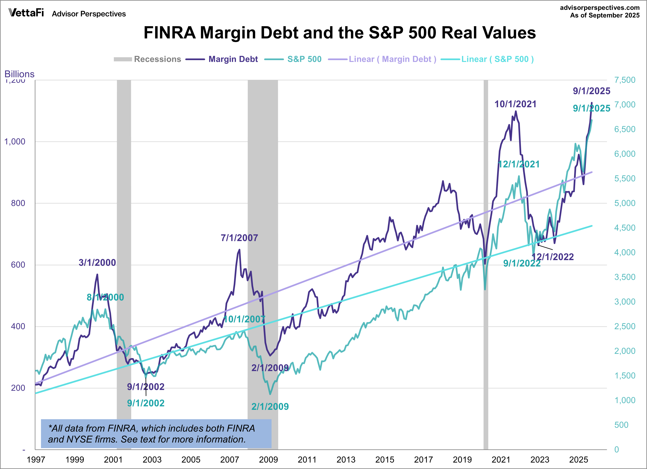
Margin Debt = $1.1 trillion
39% year-over-year

Slide 41
Economic Growth Below Natural Growth Rate
2.0%
Productivity
Economic Risks:
Worsening Trade War
Federal Reserve too slow in lowering interest rates
Decrease in stock & home prices
Russia/Ukraine war & Iran war
Productivity

Slide 42
Economic Growth Below Natural Growth Rate
2.0%
Productivity
Economic Risks:
Worsening Trade War
Federal Reserve too slow in lowering interest rates
Decrease in stock & home prices
Russia/Ukraine war & Iran war
Rise in energy prices
Productivity

Slide 43
$109.78

Slide 44
$4.45

Slide 45
Economic Growth Below Natural Growth Rate
2.0%
Productivity
Economic Risks:
Worsening Trade War
Federal Reserve too slow in lowering interest rates
Decrease in stock & home prices
Russia/Ukraine war & Iran war
Rise in energy prices
Lower-quality office property: ↓ occupancy, ↓ rent, ↓ pricing => ↓ refinancing
Productivity

Slide 46
Sales Forecast
2024: 15.8 million
2025: 16.1 million (2.0%)
2026: 16.0 million (-0.5%)

Slide 47
5.0%
Long Run
Average

Slide 48
7.7%
Long Run
Average

Slide 49
Vehicle Prices are Rising
2.5% Target
0.5%

Slide 50
Vehicle Prices are Rising
2.5% Target
0.5%
-3.2%

Slide 51
Vehicle Prices are Rising
2.0% Target
0.5%
-3.2%
Increase loan charge-offs
Decrease trade-in values

Slide 52
Source: Bureau of Labor Statistics

Slide 53
1.02%
Source: Bureau of Labor Statistics

Slide 54
1.02%
0.75%
Natural Delinquency Rate
Source: Bureau of Labor Statistics

Slide 55
Thousands

Slide 56
Thousands

Slide 57
Thousands

Slide 58
Thousands

Slide 59
Thousands

Slide 60
Thousands

Slide 61
Thousands

Slide 62
Thousands

Slide 63
Thousands

Slide 64
Thousands

Slide 65
Thousands

Slide 66
Thousands

Slide 67
Thousands

Slide 68
Thousands

Slide 69
Thousands
Service Providing
503,000 Jobs

Slide 70
4.3%

Slide 71
0.83%
4.3%

Slide 72
0.83%
4.3%
0.50%
Natural Charge-off Rate

Slide 73
0.83%
4.3%
0.50%
Natural Charge-off Rate

Slide 74
0.83%
4.3%
0.50%
Natural Charge-off Rate

Slide 75
0.83%
4.3%
0.50%
Natural Charge-off Rate

Slide 76
0.83%
4.3%
0.50%
Natural Charge-off Rate

Slide 77
0.83%
4.3%
0.50%
Natural Charge-off Rate

Slide 78
0.83%
4.3%
0.50%
Natural Charge-off Rate

Slide 79
11 Drivers of Current Credit Stress
0.83%
4.3%
0.50%
Natural Charge-off Rate

Slide 80
11 Drivers of Current Credit Stress
Ending of Pandemic-era supports created a stock of marginal borrowers and latent credit stress (a cohort effect) rather than a flow problem
0.83%
4.3%
0.50%
Natural Charge-off Rate

Slide 81
11 Drivers of Current Credit Stress
Ending of Pandemic-era supports created a stock of marginal borrowers and latent credit stress (a cohort effect) rather than a flow problem
Falling real wages (inflation > wage growth) and high price level affects low-income people more
0.83%
4.3%
0.50%
Natural Charge-off Rate

Slide 82
11 Drivers of Current Credit Stress
Ending of Pandemic-era supports created a stock of marginal borrowers and latent credit stress (a cohort effect) rather than a flow problem
Falling real wages (inflation > wage growth) and high price level affects low-income people more
High rent inflation => tight budgets
0.83%
4.3%
0.50%
Natural Charge-off Rate

Slide 83
11 Drivers of Current Credit Stress
Ending of Pandemic-era supports created a stock of marginal borrowers and latent credit stress (a cohort effect) rather than a flow problem
Falling real wages (inflation > wage growth) and high price level affects low-income people more
High rent inflation => tight budgets
Student loan payment resumption in 2023 diverted cash flows from auto debt service to student loan payments
0.83%
4.3%
0.50%
Natural Charge-off Rate

Slide 84
11 Drivers of Current Credit Stress
Ending of Pandemic-era supports created a stock of marginal borrowers and latent credit stress (a cohort effect) rather than a flow problem
Falling real wages (inflation > wage growth) and high price level affects low-income people more
High rent inflation => tight budgets
Student loan payment resumption in 2023 diverted cash flows from auto debt service to student loan payments
Higher interest rates on credit card, HELOC, ARMs raise debt service costs and credit interest rate repricing is slow on the way down.
0.83%
4.3%
0.50%
Natural Charge-off Rate

Slide 85
11 Drivers of Current Credit Stress
Ending of Pandemic-era supports created a stock of marginal borrowers and latent credit stress (a cohort effect) rather than a flow problem
Falling real wages (inflation > wage growth) and high price level affects low-income people more
High rent inflation => tight budgets
Student loan payment resumption in 2023 diverted cash flows from auto debt service to student loan payments
Higher interest rates on credit card, HELOC, ARMs raise debt service costs and credit interest rate repricing is slow on the way down.
Slow loan growth => denominator effect
0.83%
4.3%
0.50%
Natural Charge-off Rate

Slide 86
11 Drivers of Current Credit Stress
Ending of Pandemic-era supports created a stock of marginal borrowers and latent credit stress (a cohort effect) rather than a flow problem
Falling real wages (inflation > wage growth) and high price level affects low-income people more
High rent inflation => tight budgets
Student loan payment resumption in 2023 diverted cash flows from auto debt service to student loan payments
Higher interest rates on credit card, HELOC, ARMs raise debt service costs and credit interest rate repricing is slow on the way down.
Slow loan growth => denominator effect
High car insurance costs => drop collision coverage
0.83%
4.3%
0.50%
Natural Charge-off Rate

Slide 87
11 Drivers of Current Credit Stress
Ending of Pandemic-era supports created a stock of marginal borrowers and latent credit stress (a cohort effect) rather than a flow problem
Falling real wages (inflation > wage growth) and high price level affects low-income people more
High rent inflation => tight budgets
Student loan payment resumption in 2023 diverted cash flows from auto debt service to student loan payments
Higher interest rates on credit card, HELOC, ARMs raise debt service costs and credit interest rate repricing is slow on the way down.
Slow loan growth => denominator effect
High car insurance costs => drop collision coverage
Walk Away Auto Repos from underwater borrowers and high priced 2021-2023 autos
0.83%
4.3%
0.50%
Natural Charge-off Rate

Slide 88
11 Drivers of Current Credit Stress
Ending of Pandemic-era supports created a stock of marginal borrowers and latent credit stress (a cohort effect) rather than a flow problem
Falling real wages (inflation > wage growth) and high price level affects low-income people more
High rent inflation => tight budgets
Student loan payment resumption in 2023 diverted cash flows from auto debt service to student loan payments
Higher interest rates on credit card, HELOC, ARMs raise debt service costs and credit interest rate repricing is slow on the way down.
Slow loan growth => denominator effect
High car insurance costs => drop collision coverage
Walk Away Auto Repos from underwater borrowers and high priced 2021-2023 autos
2022 vintage loans (with looser underwriting) have now seasoned and are showing credit losses
0.83%
4.3%
0.50%
Natural Charge-off Rate

Slide 89
11 Drivers of Current Credit Stress
Ending of Pandemic-era supports created a stock of marginal borrowers and latent credit stress (a cohort effect) rather than a flow problem
Falling real wages (inflation > wage growth) and high price level affects low-income people more
High rent inflation => tight budgets
Student loan payment resumption in 2023 diverted cash flows from auto debt service to student loan payments
Higher interest rates on credit card, HELOC, ARMs raise debt service costs and credit interest rate repricing is slow on the way down.
Slow loan growth => denominator effect
High car insurance costs => drop collision coverage
Walk Away Auto Repos from underwater borrowers and high priced 2021-2023 autos
2022 vintage loans (with looser underwriting) have now seasoned and are showing credit losses
Lower quality jobs (more service sector, volatile gig income, more part time for economic reasons)
0.83%
4.3%
0.50%
Natural Charge-off Rate

Slide 90
11 Drivers of Current Credit Stress
Ending of Pandemic-era supports created a stock of marginal borrowers and latent credit stress (a cohort effect) rather than a flow problem
Falling real wages (inflation > wage growth) and high price level affects low-income people more
High rent inflation => tight budgets
Student loan payment resumption in 2023 diverted cash flows from auto debt service to student loan payments
Higher interest rates on credit card, HELOC, ARMs raise debt service costs and credit interest rate repricing is slow on the way down.
Slow loan growth => denominator effect
High car insurance costs => drop collision coverage
Walk Away Auto Repos from underwater borrowers and high priced 2021-2023 autos
2022 vintage loans (with looser underwriting) have now seasoned and are showing credit losses
Lower quality jobs (more service sector, volatile gig income, more part time for economic reasons)
Falling creditworthiness among low-to-moderate income households who drive most consumer credit losses
0.83%
4.3%
0.50%
Natural Charge-off Rate

Slide 91
Inflation Above 2% Target
Economic Truism
Core Inflation Today
Predicts
Headline Inflation Tomorrow
2.0% Target
March
2026
3.2%
Source: Bureau of Labor Statistics

Slide 92
Inflation Above 2% Target
2.8% average last 24 months
2.0% Target
March
2026
3.2%
Source: Bureau of Labor Statistics

Slide 93
Inflation Above 2% Target
War: higher oil & commodity prices
Deglobalization & disrupted supply chains
Pass Through Tariffs
Zero immigration => tight labor supply
2.0% Target
Source: Bureau of Labor Statistics

Slide 94
Inflation Above 2% Target
War: higher oil & commodity prices
Deglobalization & disrupted supply chains
Pass Through Tariffs
Zero immigration => tight labor supply
2.0% Target
Productivity enhancing AI
Falling shelter costs
Source: Bureau of Labor Statistics

Slide 95
Inflation Above 2% Target
2.0% Target
Inflation Takeaways:
↑ HH financial stress
↑ loan delinquency rates
↑ Interest rates
↑ Labor costs
↑ Operating expenses
Lower consumer confidence
Source: Bureau of Labor Statistics

Slide 96
July 2023
5.35%
Fastest increase in
interest rates
in 40 years
(5.25)
3
3.0% Neutral Interest Rate
2% Inflation
1% Real Equilibrium
Braking the Economy
2
1
Two Paths
Drop rates 0.50
(Focus on Labor Market)
Hold rates
(Focus on Inflation)
Raise rates
(Inflation is becoming entrenched)
Accelerating the
Economy
Source: Federal Reserve

Slide 97
Credit Union
Balance Sheet

Slide 98
Credit Union
Balance Sheet
Assets

Slide 99
Credit Union
Balance Sheet
Assets
Liabilities + Capital

Slide 100
Credit Union
Balance Sheet
Assets
Liabilities + Capital
Deposits
Checking Accounts
Savings
Money Market Deposits
Certificates of Deposits

Slide 101
Stronger Credit Union Savings Growth
7 %
long run
average

Slide 102
6%
Long Run
Average
4.1%
Savings Rate
Source: Bureau of Economic Analysis

Slide 103
6%
Long Run
Average
4.1%
Savings Rate
Source: Bureau of Economic Analysis

Slide 104
Low-Savings Rate Impact:
Short Run: Boost spending and economy
Long Run: Increase financial stress in recession
6%
Long Run
Average
4.1%
Savings Rate
Source: Bureau of Economic Analysis

Slide 105
91.8

Slide 106
91.8
< 90 => Recession

Slide 107
47.6

Slide 108
< 80 => Recession
47.6

Slide 109
Credit Union
Balance Sheet
Assets
Liabilities + Capital
Cash (Reserves)
Deposits
Checking Accounts
Savings
Money Market Deposits
Certificates of Deposits
Investments
< 1 year maturity 50%
1–3 year maturity 19%
> 3-year maturity 31%

Slide 110
Investments Are Low but Yields Are Rising
36.5%
32%
Long Run
Average
25.7%

Slide 111
Credit Union
Balance Sheet
Assets
Liabilities + Capital
Cash (Reserves)
Deposits
Checking Accounts
Savings
Money Market Deposits
Certificates of Deposits
Investments
< 1 year maturity
1–3-year maturity
> 3-year maturity
Loans
Commercial
Auto
Home
Credit Card

Slide 112
Slow Credit Union Loan Growth

Slide 113
Credit Union
Balance Sheet
Assets
Liabilities + Capital
Cash (Reserves)
Deposits
Checking Accounts
Savings
Money Market Deposits
Certificates of Deposits
Fixed Assets
Land
Building
Equipment
Borrowings
Federal Home Loan Bank
Corporate Line of Credit
Fed Funds Purchased
Bank Term Funding Program
Investments
< 1 year maturity
1–3-year maturity
> 3-year maturity
Loans
Commercial
Auto
Home
Credit Card
Equity (Net Capital)
Undivided Earnings
Regular Reserves
Gains (losses) on Available For Sale (AFS) Securities

Slide 114
Credit Union
Balance Sheet
Assets
Liabilities + Capital
Cash (Reserves)
Deposits
Checking Accounts
Savings
Money Market Deposits
Certificates of Deposits
Fixed Assets
Land
Building
Equipment
Borrowings
Federal Home Loan Bank
Corporate Line of Credit
Fed Funds Purchased
Bank Term Funding Program
Investments
< 1 year maturity
1–3-year maturity
> 3-year maturity
Loans
Commercial
Auto
Home
Credit Card
Equity (Net Capital)
Undivided Earnings
Regular Reserves
Gains (losses) on Available For Sale (AFS) Securities
Allowance for Loan Loss

Slide 116
COVID Pandemic

Slide 117
Current Expected Credit Loss Model CECL
COVID Pandemic

Slide 118
78 basis points
long run
average

Slide 119
78 basis points
long run
average
2026
Rising Net Interest Margins
Falling Operating Expense ratios

Slide 120
Economic Update Summary For 2026

Slide 121
Economic Update Summary For 2026
Below trend economic growth in 2026, (1.9%)

Slide 122
Economic Update Summary For 2026
Below trend economic growth in 2026, (1.9%)
Inflation remaining above target during the next 2 years

Slide 123
Economic Update Summary For 2026
Below trend economic growth in 2026, (1.9%)
Inflation remaining above target during the next 2 years
Unemployment rate rising to natural rate of 4.5% in 2026

Slide 124
Economic Update Summary For 2026
Below trend economic growth in 2026, (1.9%)
Inflation remaining above target during the next 2 years
Unemployment rate rising to natural rate of 4.5% in 2026
Short-term interest rates unchanged in 2026

Slide 125
Economic Update Summary For 2026
Below trend economic growth in 2026, (1.9%)
Inflation remaining above target during the next 2 years
Unemployment rate rising to natural rate of 4.5% in 2026
Short-term interest rates unchanged in 2026
Credit union loan growth below trend in 2026, (5.5%)

Slide 126
Economic Update Summary For 2026
Below trend economic growth in 2026, (1.9%)
Inflation remaining above target during the next 2 years
Unemployment rate rising to natural rate of 4.5% in 2026
Short-term interest rates unchanged in 2026
Credit union loan growth below trend in 2026, (5.5%)
Credit Union Return on Assets expected to rise to 0.80% in 2026

Slide 127
Credit unions are so robust that,…..

Slide 128
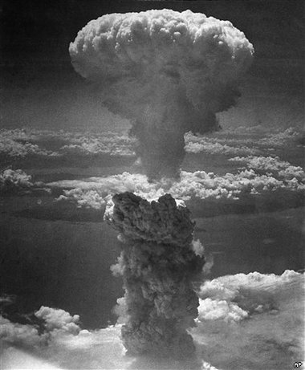
Credit unions are so robust that,…..

Slide 129

Credit unions are so robust that,…..

Slide 130
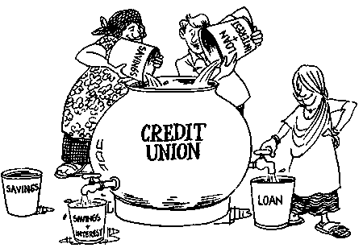
Credit unions are so robust that,…..

Slide 131

Credit unions are so robust that,…..

Slide 132
Carpe Diem
“Seize the day”

Slide 133
Questions?

Slide 135
The End

Slide 136
Economic Forecast
April 2026
 | Past results |  | Quarterly Actual/Forecasts |  |  |  | Annual Forecasts
 | Previous 10 Yr. Avg | 2025 | 2026 Q1 | 2026 Q2 | 2026 Q3 | 2026 Q4 | 2026 | 2027
Growth rates:
Economic Growth (% chg GDP)* | 2.5% | 2.1% | 2.0% | 1.5% | 2.0% | 2.0% | 1.9% | 2.0%
Inflation (CPI, 12 mth % chg) | 3.3% | 2.7% | 3.3% | 3.5% | 3.2% | 3.0% | 3.0% | 2.8%
Unemployment Rate (BLS) | 4.3% | 4.4% | 4.4% | 4.4% | 4.5% | 4.5% | 4.5% | 4.5%
Federal Funds Rate (effective) | 2.36% | 3.64% | 3.64% | 3.60% | 3.60% | 3.60% | 3.60% | 3.40%
10-Year Treasury Rate | 2.84% | 4.18% | 4.30% | 4.30% | 4.25% | 4.25% | 4.25% | 4.20%
10-Year-Fed Funds Spread | 0.48% | 0.54% | 0.66% | 0.66% | 0.61% | 0.61% | 0.61% | 0.80%
*Percent change, annualized rate for quarterly and Q4-to-Q4 change for annual. All other numbers are end-of-period values.

Slide 137
Credit Union Forecast
April 2026
 | Past Results |  | Forecasts |  |  |  | Annual Forecasts
 | 10 Yr Average | 2025 | 2026 Q1 | 2026 Q2 | 2026 Q3 | 2026 Q4 | 2026 | 2027
Growth rates:
Savings growth | 7.3% | 5.5% | 4.0% | 0.5% | 0.5% | 1.5% | 6.5% | 7.0%
Loan growth | 8.1% | 4.6% | 0.2% | 1.9% | 2.0% | 1.3% | 5.5% | 6.0%
Asset growth | 7.3% | 5.4% | 3.5% | 0.8% | 0.8% | 1.1% | 6.2% | 6.5%
Membership growth | 3.5% | 1.6% | 0.4% | 0.8% | 0.5% | 0.1% | 1.8% | 2.0%
Liquidity:
Loan-to-share ratio** | 81.15% | 83.2% | 80.1% | 81.0% | 82.0% | 81.6% | 81.6% | 80.5%
Asset quality:
Delinquency rate** | 0.75% | 1.02% | 0.95% | 1.00% | 1.00% | 1.00% | 1.00% | 0.90%
Net charge-off rate* | 0.55% | 0.78% | 0.80% | 0.80% | 0.80% | 0.80% | 0.80% | 0.75%
Earnings:
Return on average assets (ROA)* | 0.67% | 0.76% | 0.80% | 0.75% | 0.75% | 0.75% | 0.75% | 0.80%
Capital adequacy:
Net worth ratio** | 10.9% | 11.3% | 11.1% | 11.2% | 11.3% | 11.4% | 11.4% | 11.4%
*Quarterly data, annualized. **End of period ratio. Net worth forecast does not account for CECL Provision

Slide 138
Stablecoin Issuer Business Model
Balance Sheet View
Stablecoin Issuer Balance Sheet
Assets
Liabilities + Capital
Investments
US Treasury Bills
Money Market Funds
Cash
Stablecoins Issued
Digital Tokens Redeemable 1:1 for USD
The primary liability for issuers are the stablecoins themselves.
The bulk of issuers’ assets are high-quality, liquid investments (Treasury bills, money market funds).
Operating Liabilities
Accounts Payables
Accrued Expenses
Other Assets
Technology and Equipment
Working Capital
Intellectual Property, etc.
Equity (Capital Buffer)

Slide 139
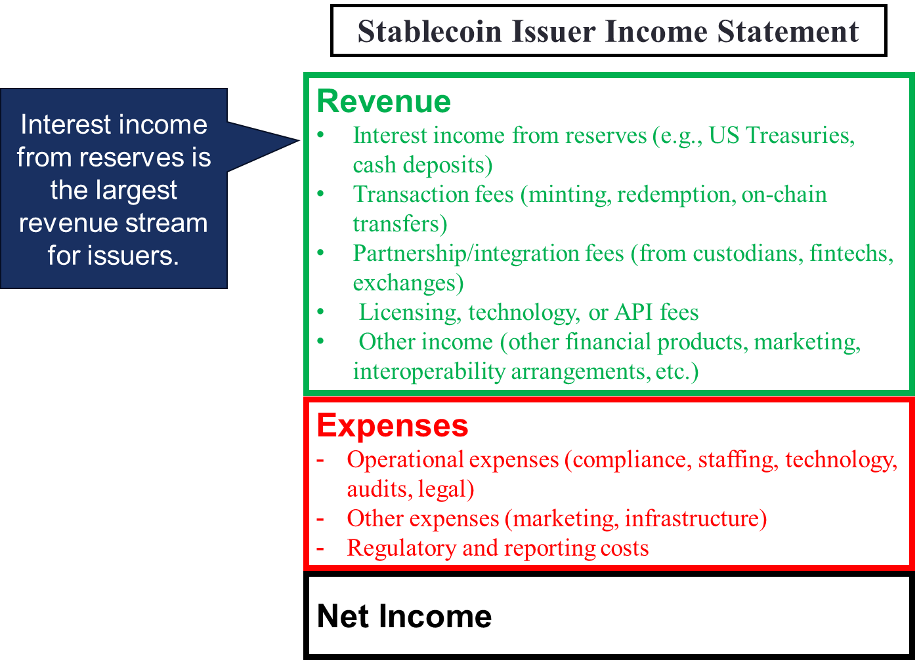
Stablecoin Issuer Business Model
Income Statement View

Slide 140
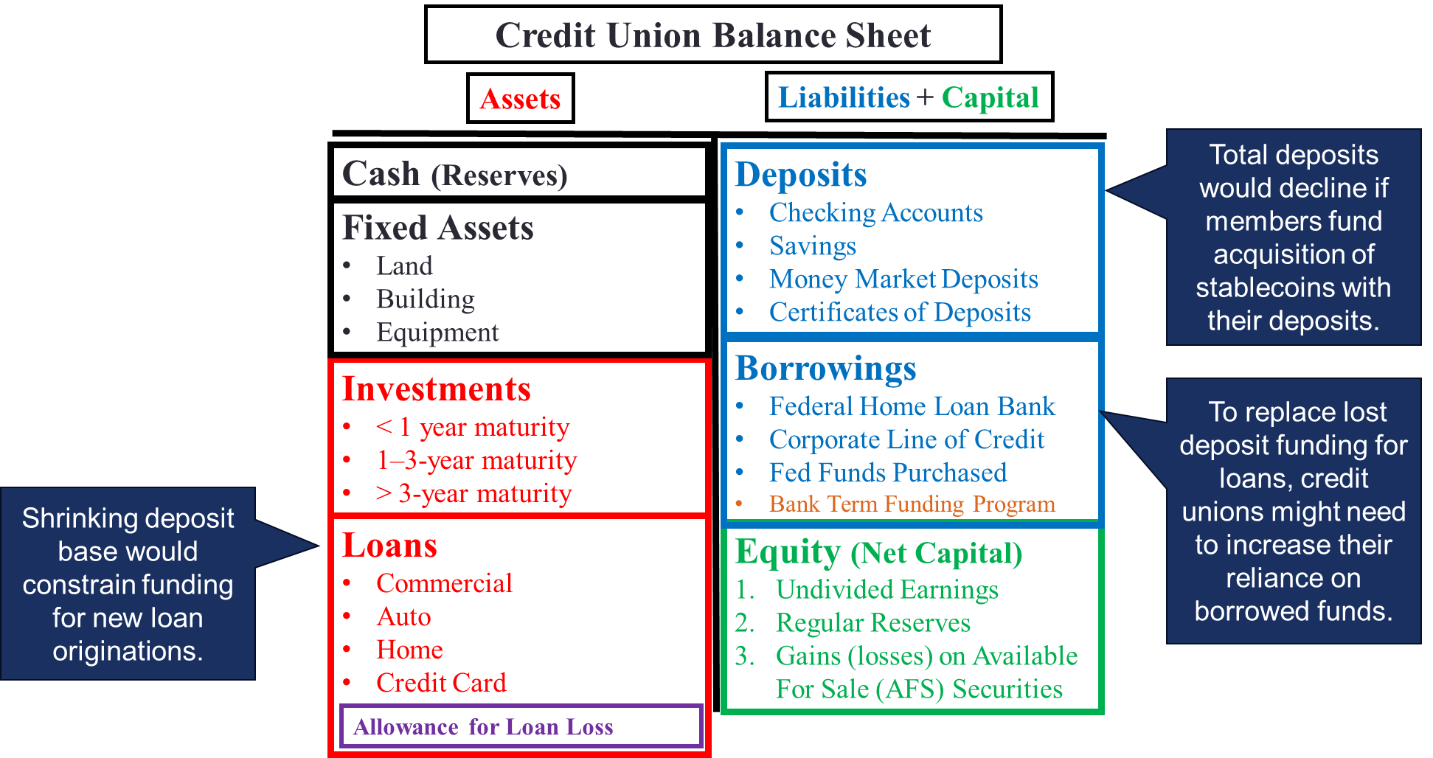
Implications for CU Balance Sheets
Note: The GENIUS Act prohibits NCUA from requiring a credit union to record stablecoins held in custody on its balance sheet as a liability. Instead, they are to be treated as assets held in custody for clients, so they are off-balance sheet. As a result, they are not treated as a balance sheet risk, which would otherwise require the credit union to hold additional regulatory capital against them.

Slide 141
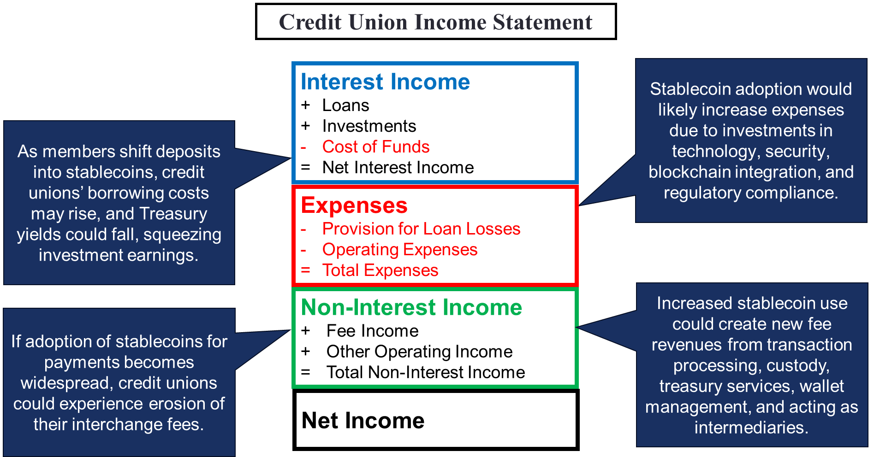
Implications for CU Income Statements

Slide 142
Wage Growth Slowing as Core Inflation Falls
3.7%
Source: Bureau of Labor Statistics

Slide 143
Wage Growth Slowing as Core Inflation Falls
3.7%
2.5%
Core Inflation
Source: Bureau of Labor Statistics

Slide 144
Wage Growth Slowing as Core Inflation Falls
3.7%
2.5%
Core Inflation
Source: Bureau of Labor Statistics

Slide 145
Wage Growth Slowing as Core Inflation Falls
3.7%
2.5%
2024-2025
Rising Real Wages
Core Inflation
Source: Bureau of Labor Statistics

Slide 146
6,542
Source: Bureau of Labor Statistics

Slide 147
6,542
5,293
Source: Bureau of Labor Statistics

Slide 148
6,542
5,293
3,204
Source: Bureau of Labor Statistics

Slide 149
170,000
Long Run Average
47,000
Source: Bureau of Labor Statistics

